Slide 1
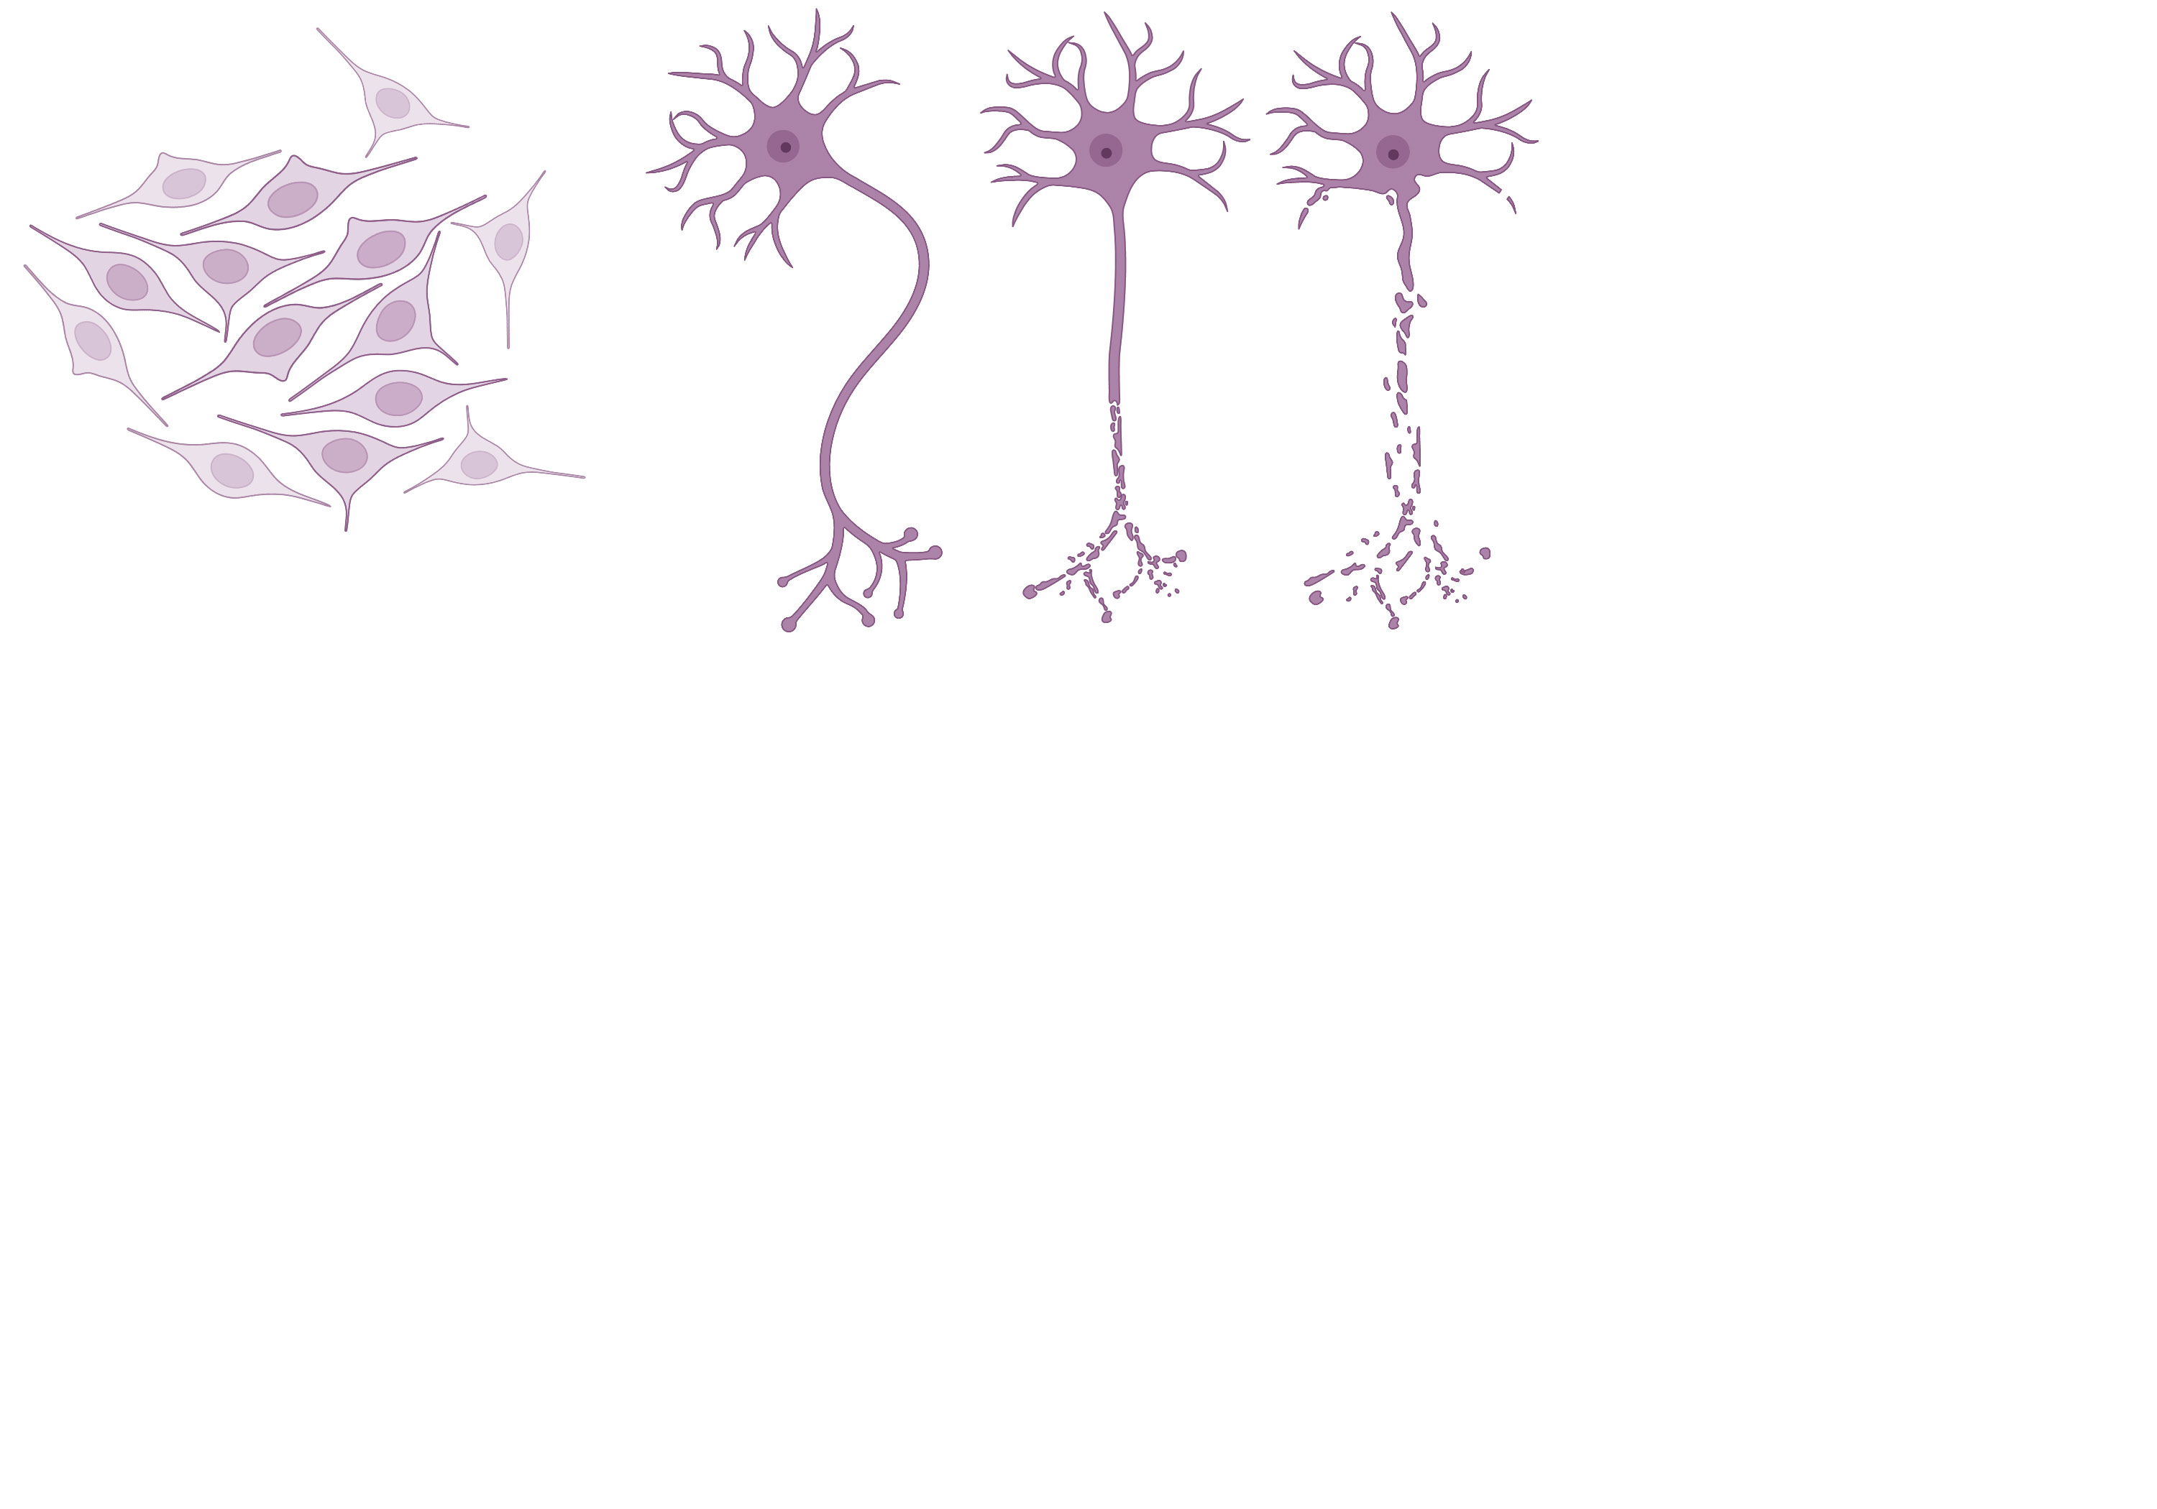













$n_{m}$ Modalities
(Gene Expression, Chromatin Accessibility, etc.)
Collaborative Reinforcement Learning Environment
$$M_{n_{m}}$$
Development and Disease Trajectory Reconstruction
$$⋯$$
?
$$M_{1}$$
$n_{c}$ Cells
Perturbation Analysis and Feature Prioritization
$$v_{2}$$
?
$$x_{2}$$
$$v_{1}$$
$$x_{1}$$
$$m_{1}$$
$$m_{2}$$
$$⋯$$
$$m_{n_{m1}}$$
$n_{mi}$ Features

